Slide 1
Properties of Relational Decompositions (6)
Lossless (Non-additive) Join Property of a Decomposition (cont.):
Algorithm 11.1: Testing for Lossless Join Property
  Input: A universal relation R, a decomposition D = {R1, R2, ..., Rm} of R, and a set F of functional dependencies.
1. Create an initial matrix S with one row i for each relation Ri in D, and one column j for each attribute Aj in R.
2. Set S(i,j):=bij for all matrix entries. (* each bij is a distinct symbol associated with indices (i,j) *).
3. For each row i representing relation schema Ri
{for each column j representing attribute Aj
{if (relation Ri includes attribute Aj) then set S(i,j):= aj;};};
  (* each aj is a distinct symbol associated with index (j) *)
  CONTINUED on NEXT SLIDE
Slide 11- <number>

Slide 2
Properties of Relational Decompositions (7)
Lossless (Non-additive) Join Property of a Decomposition (cont.):
Algorithm 11.1: Testing for Lossless Join Property
4. Repeat the following loop until a complete loop execution results in no changes to S
{for each functional dependency X Y in F
{for all rows in S which have the same symbols in the columns corresponding to attributes in X
{make the symbols in each column that correspond to an attribute in Y be the same in all these rows as follows:
If any of the rows has an “a” symbol for the column, set the other rows to that same “a” symbol in the column.
If no “a” symbol exists for the attribute in any of the rows, choose one of the “b” symbols that appear in one of the rows for the attribute and set the other rows to that same “b” symbol in the column ;};
};
};
5. If a row is made up entirely of “a” symbols, then the decomposition has the lossless join property; otherwise it does not.
Slide 11- <number>

Slide 3
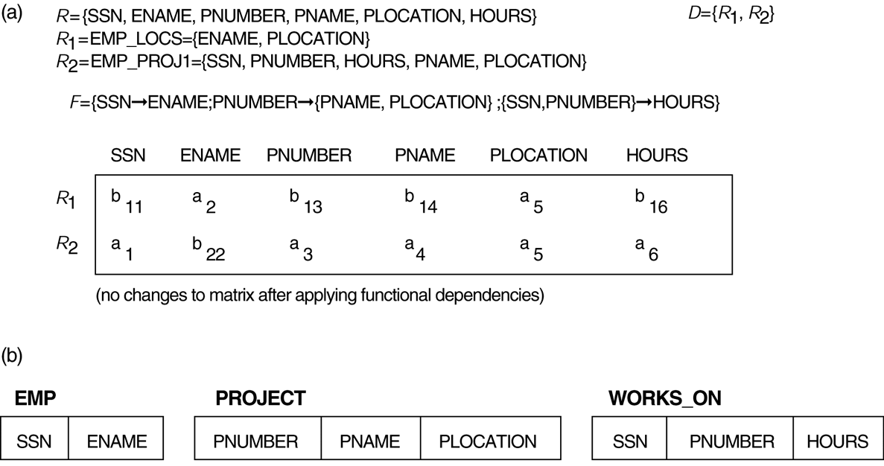
Properties of Relational Decompositions (8)
Lossless (nonadditive) join test for n-ary decompositions.
(a) Case 1: Decomposition of EMP_PROJ into EMP_PROJ1 and EMP_LOCS fails test.
(b) A decomposition of EMP_PROJ that has the lossless join property.
Slide 11- <number>

Slide 4
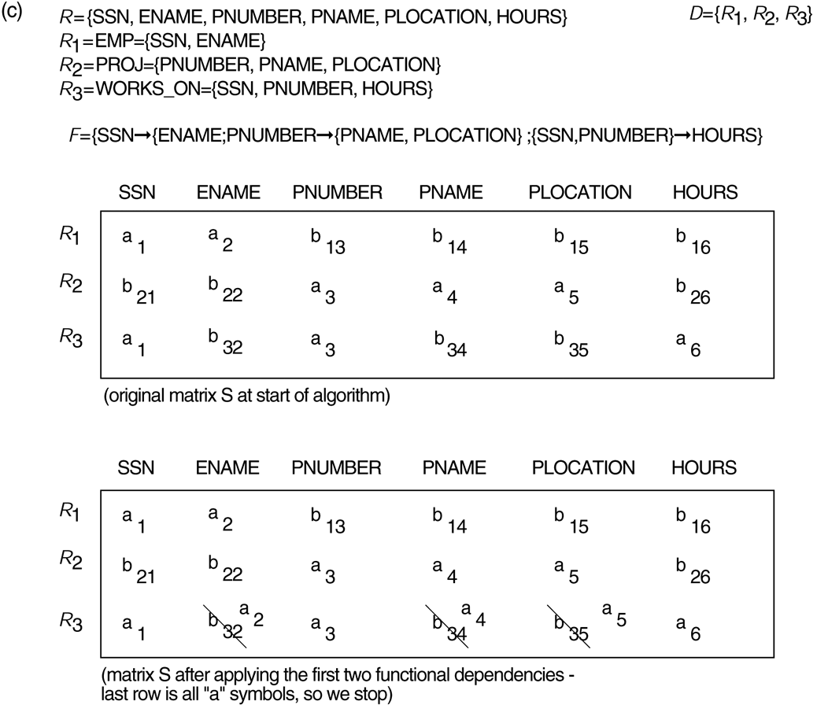
Properties of Relational Decompositions (8)
Lossless (nonadditive) join test for n-ary decompositions.
(c) Case 2: Decomposition of EMP_PROJ into EMP, PROJECT, and WORKS_ON satisfies test.
Slide 11- <number>

